Slide 1
Lecture 11
LINQ

Slide 2
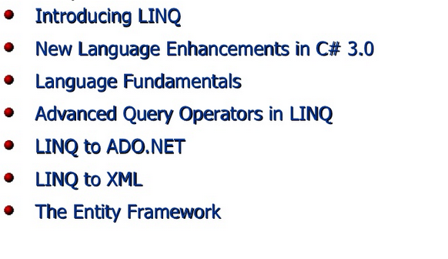

Slide 3
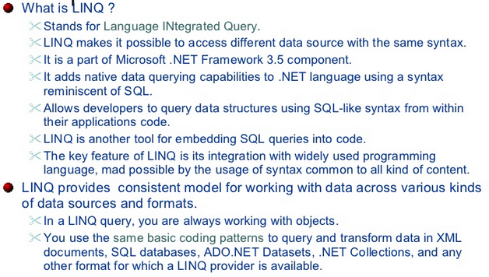

Slide 4
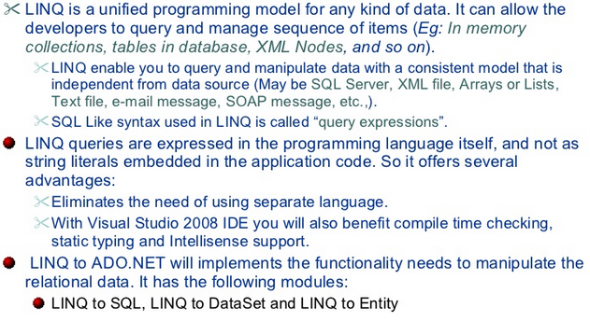

Slide 5
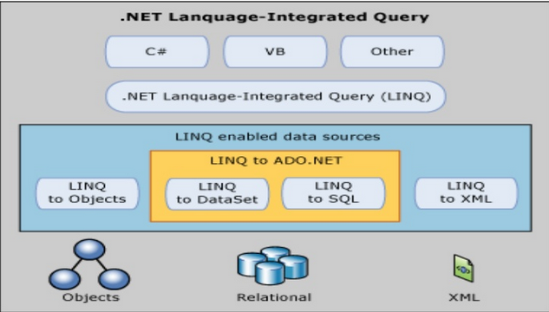

Slide 6
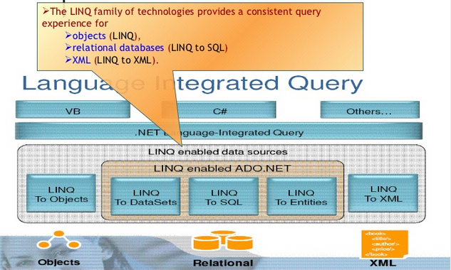

Slide 7
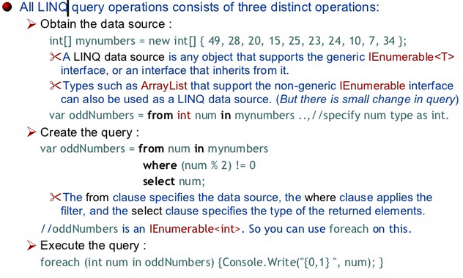

Slide 8
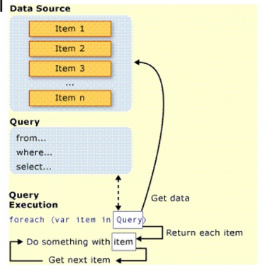

Slide 9
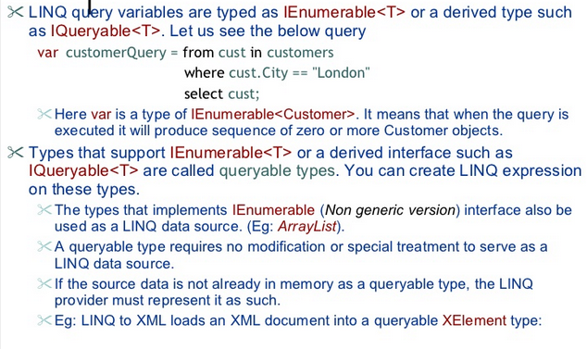

Slide 10
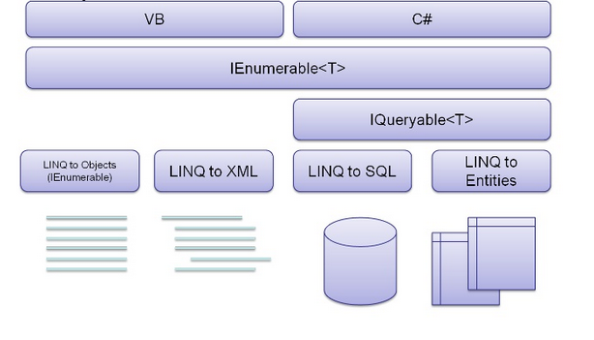

Slide 11
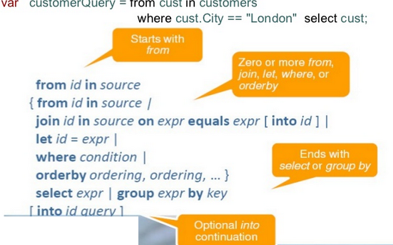

Slide 12
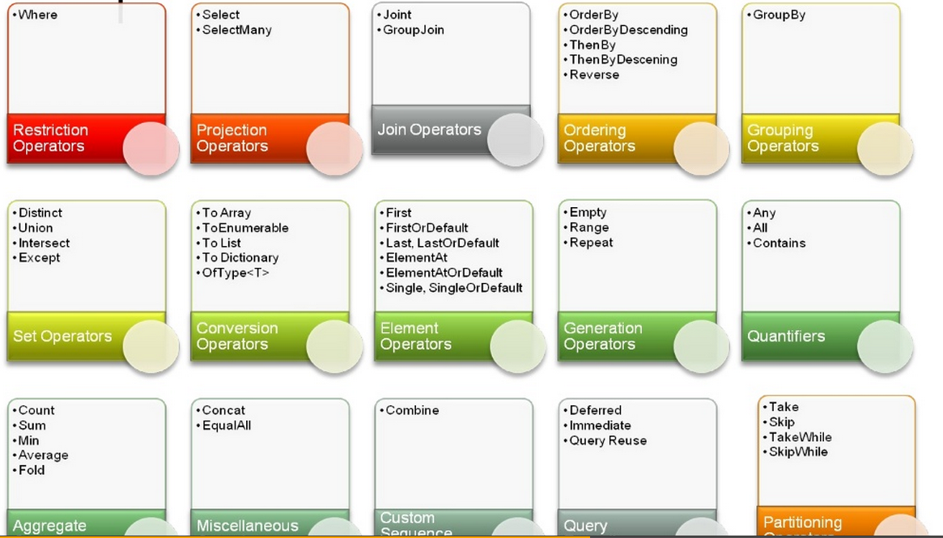

Slide 13
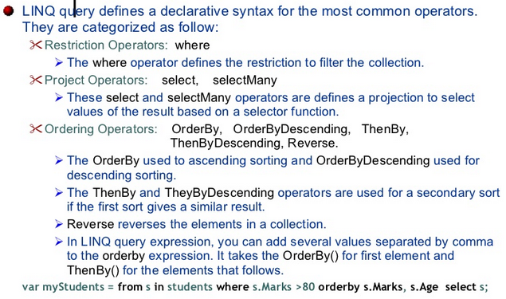

Slide 14
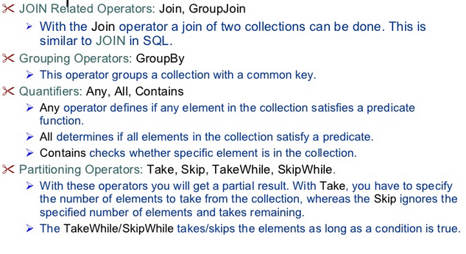

Slide 15
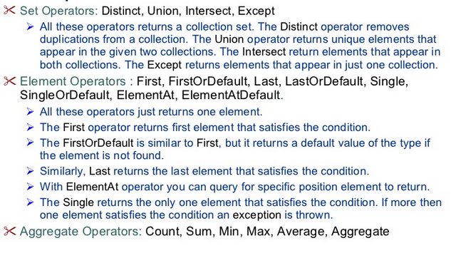

Slide 16
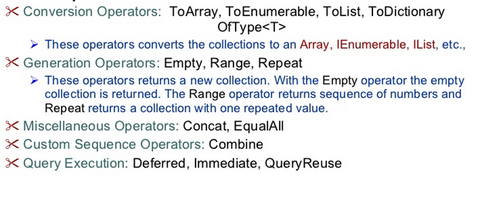

Slide 17
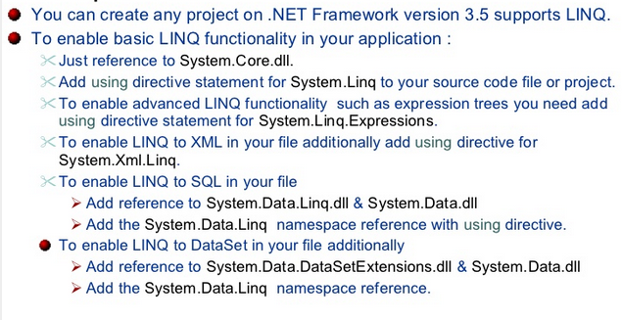

Slide 18
SAMPLES

Slide 19
static void QueryOverStrings()
{
string[] currentVideoGames = {"Morrowind", "Uncharted 2",
"Fallout 3", "Daxter", "System Shock 2"};
// Build a query expression to find the items in the array
// that have an embedded space.
IEnumerable<string> subset = from g in currentVideoGames
where g.Contains(" ") orderby g select g;
foreach (string s in subset)
Console.WriteLine("Item: {0}", s);
}

Slide 20
static void QueryOverInts()
{
int[] numbers = {10, 20, 30, 40, 1, 2, 3, 8};
// Print only items less than 10.
IEnumerable<int> subset = from i in numbers where i < 10 select i;
foreach (int i in subset)
Console.WriteLine("Item: {0}", i);
}

Slide 21
static void ImmediateExecution()
{
int[] numbers = { 10, 20, 30, 40, 1, 2, 3, 8 };
// Get data RIGHT NOW as int[].
int[] subsetAsIntArray =
(from i in numbers where i < 10 select i).ToArray<int>();
// Get data RIGHT NOW as List<int>.
List<int> subsetAsListOfInts =
(from i in numbers where i < 10 select i).ToList<int>();
}

Slide 22
Applying LINQ Queries to Collection Objects
class Car
{
public string PetName {get; set;}
public string Color {get; set;}
public int Speed {get; set;}
public string Make {get; set;}
}
static void Main(string[] args)
{
Console.WriteLine("***** LINQ over Generic Collections *****\n");
// Make a List<> of Car objects.
List<Car> myCars = new List<Car>() {
new Car{ PetName = "Henry", Color = "Silver", Speed = 100, Make = "BMW"},
new Car{ PetName = "Daisy", Color = "Tan", Speed = 90, Make = "BMW"},
new Car{ PetName = "Mary", Color = "Black", Speed = 55, Make = "VW"},
new Car{ PetName = "Clunker", Color = "Rust", Speed = 5, Make = "Yugo"},
new Car{ PetName = "Melvin", Color = "White", Speed = 43, Make = "Ford"}
};
Console.ReadLine();
}

Slide 23
static void GetFastCars(List<Car> myCars)
{
// Find all Car objects in the List<>, where the Speed is
// greater than 55.
var fastCars = from c in myCars where c.Speed > 55 select c;
foreach (var car in fastCars)
{
Console.WriteLine("{0} is going too fast!", car.PetName);
}
}

Slide 24
Projecting New Data Types
static void GetNamesAndDescriptions(ProductInfo[] products)
{
Console.WriteLine("Names and Descriptions:");
var nameDesc = from p in products select new { p.Name, p.Description };
foreach (var item in nameDesc)
{
// Could also use Name and Description properties directly.
Console.WriteLine(item.ToString());
}
}

Slide 25
Obtaining Counts Using Enumerable
static void GetCountFromQuery()
{
string[] currentVideoGames = {"Morrowind", "Uncharted 2",
"Fallout 3", "Daxter", "System Shock 2"};
// Get count from the query.
int numb =
(from g in currentVideoGames where g.Length > 6 select g).Count();
// Print out the number of items.
Console.WriteLine("{0} items honor the LINQ query.", numb);
}

Slide 26
Reversing Result Sets
static void ReverseEverything(ProductInfo[] products)
{
Console.WriteLine("Product in reverse:");
var allProducts = from p in products select p;
foreach (var prod in allProducts.Reverse())
{
Console.WriteLine(prod.ToString());
}
}

Slide 27
Sorting Expressions
static void AlphabetizeProductNames(ProductInfo[] products)
{
// Get names of products, alphabetized.
var subset = from p in products orderby p.Name select p;
foreach (var p in subset)
{
Console.WriteLine(p.ToString());
}
}

Slide 28
static void DisplayDiff()
{
List<string> myCars = new List<String> {"Yugo", "Aztec", "BMW"};
List<string> yourCars = new List<String>{"BMW", "Saab", "Aztec" };
var carDiff =(from c in myCars select c)
.Except(from c2 in yourCars select c2);
Console.WriteLine("Here is what you don't have, but I do:");
foreach (string s in carDiff)
Console.WriteLine(s); // Prints Yugo.
}

Slide 29
static void DisplayIntersection()
{
List<string> myCars = new List<String> { "Yugo", "Aztec", "BMW" };
List<string> yourCars = new List<String> { "BMW", "Saab", "Aztec" };
// Get the common members.
var carIntersect = (from c in myCars select c)
.Intersect(from c2 in yourCars select c2);
Console.WriteLine("Here is what we have in common:");
foreach (string s in carIntersect)
Console.WriteLine(s); // Prints Aztec and BMW.
}

Slide 30
static void DisplayUnion()
{
List<string> myCars = new List<String> { "Yugo", "Aztec", "BMW" };
List<string> yourCars = new List<String> { "BMW", "Saab", "Aztec" };
// Get the union of these containers.
var carUnion = (from c in myCars select c)
.Union(from c2 in yourCars select c2);
Console.WriteLine("Here is everything:");
foreach (string s in carUnion)
Console.WriteLine(s); // Prints all common members.
}

Slide 31
static void DisplayConcat()
{
List<string> myCars = new List<String> { "Yugo", "Aztec", "BMW" };
List<string> yourCars = new List<String> { "BMW", "Saab", "Aztec" };
var carConcat = (from c in myCars select c)
.Concat(from c2 in yourCars select c2);
// Prints:
// Yugo Aztec BMW BMW Saab Aztec.
foreach (string s in carConcat)
Console.WriteLine(s);
}

Slide 32
static void DisplayConcatNoDups()
{
List<string> myCars = new List<String> { "Yugo", "Aztec", "BMW" };
List<string> yourCars = new List<String> { "BMW", "Saab", "Aztec" };
var carConcat = (from c in myCars select c)
.Concat(from c2 in yourCars select c2);
// Prints:
// Yugo Aztec BMW Saab Aztec.
foreach (string s in carConcat.Distinct())
Console.WriteLine(s);
}

Slide 33
LINQ Aggregation Operations
static void AggregateOps()
{
double[] winterTemps = { 2.0, -21.3, 8, -4, 0, 8.2 };
// Various aggregation examples.
Console.WriteLine("Max temp: {0}",
(from t in winterTemps select t).Max());
Console.WriteLine("Min temp: {0}",
(from t in winterTemps select t).Min());
Console.WriteLine("Avarage temp: {0}",
(from t in winterTemps select t).Average());
Console.WriteLine("Sum of all temps: {0}",
(from t in winterTemps select t).Sum());
}

Slide 34
static void QueryStringWithOperators()
{
Console.WriteLine("***** Using Query Operators *****");
string[] currentVideoGames = {"Morrowind", "Uncharted 2",
"Fallout 3", "Daxter", "System Shock 2"};
var subset = from game in currentVideoGames
where game.Contains(" ") orderby game select game;
foreach (string s in subset)
Console.WriteLine("Item: {0}", s);
}

Slide 35
Building Query Expressions Using the Enumerable Type and
Lambda Expressions
static void QueryStringsWithEnumerableAndLambdas()
{
Console.WriteLine("***** Using Enumerable / Lambda Expressions *****");
string[] currentVideoGames = {"Morrowind", "Uncharted 2",
"Fallout 3", "Daxter", "System Shock 2"};
// Build a query expression using extension methods
// granted to the Array via the Enumerable type.
var subset = currentVideoGames.Where(game => game.Contains(" "))
.OrderBy(game => game).Select(game => game);
// Print out the results.
foreach (var game in subset)
Console.WriteLine("Item: {0}", game);
Console.WriteLine();
}

Slide 36
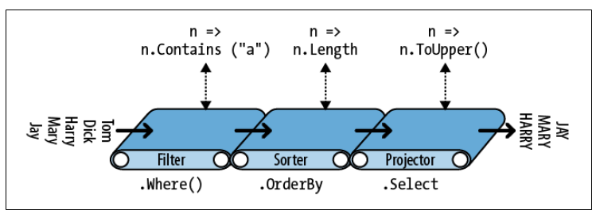
string[] names = { "Tom", "Dick", "Harry", "Mary", "Jay" };
IEnumerable<string> query = names
.Where (n => n.Contains ("a"))
.OrderBy (n => n.Length)
.Select (n => n.ToUpper());
foreach (string name in query) Console.WriteLine (name);

Slide 37
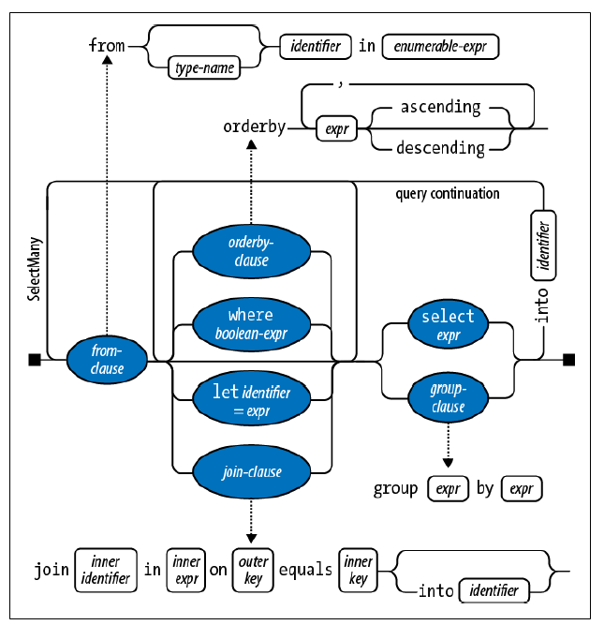

Slide 38
The into Keyword
IEnumerable<string> query =
from n in names
select n.Replace ("a", "").Replace ("e", "").Replace ("i", "")
.Replace ("o", "").Replace ("u", "")
into noVowel
where noVowel.Length > 2 orderby noVowel select noVowel;

Slide 39
The let Keyword
string[] names = { "Tom", "Dick", "Harry", "Mary", "Jay" };
IEnumerable<string> query =
from n in names
let vowelless = n.Replace ("a", "").Replace ("e", "").Replace ("i", "")
.Replace ("o", "").Replace ("u", "")
where vowelless.Length > 2
orderby vowelless
select n; // Thanks to let, n is still in scope.

Slide 40
JOIN
// Join with query expression.
var result = from t in ints1
join x in ints2 on (t + 1) equals x select t;
Most common join types:
Inner join
Group join
Left outer join

Slide 41
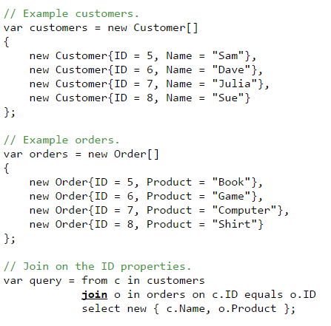

Slide 42
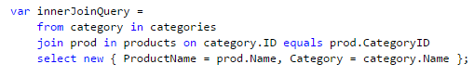
INNER JOIN

Slide 43
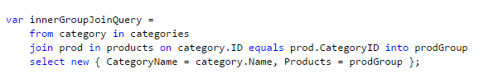
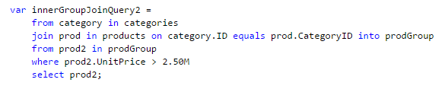
INNER GROUP JOIN

Slide 44
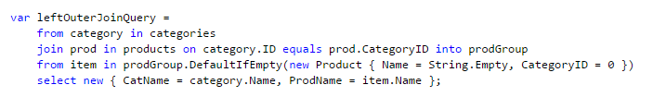
LEFT OUTER JOIN

Slide 45
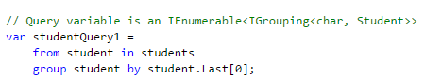
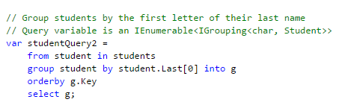
Group clause

Slide 46
